Slide 1
HoMonit: Monitoring Smart Home Apps from Encrypted Traffic
Keerthi Koneru
Student ID : 1712696
University of California, SantaCruz
Prof: Dr.Chen Qian

Slide 2
Outline
Introduction
Background
Motivation
Design Overview
Building DFA via SmartApp Analysis
Apps misbehavior detection
Evaluation
Discussion
Conclusion

Slide 3
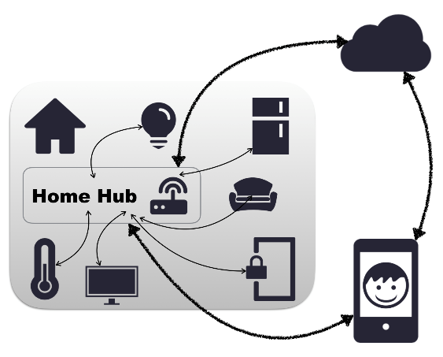
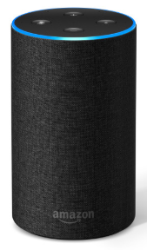
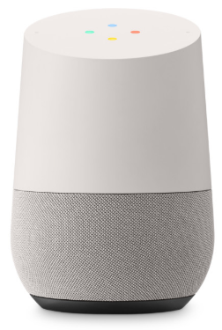
Introduction
Smart Home – concept of Internet of things.
An emerging technology that supports to intelligently connect and control multiple devices and allow them to work together.
Smart Home platforms like ‘Home Hub’ support inter-vendor compatibility of several smart devices. Example: SmartThings
Amazon Echo
Google Home
Apple HomeKit

Slide 4
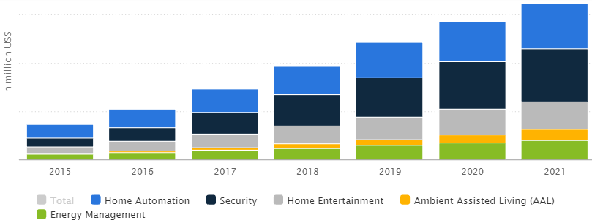
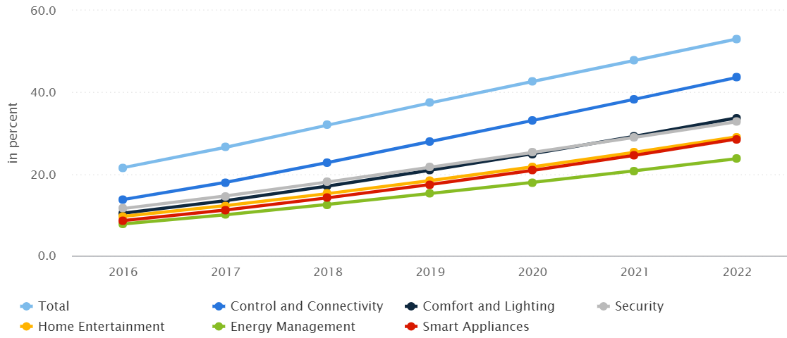
Smart Home – Usage Statistics
Market Revenue
$18,877 million in 2018
Annual growth rate: 14.8%
Household penetration
32% in 2018
Expected in 2022: 53.1%

Slide 5
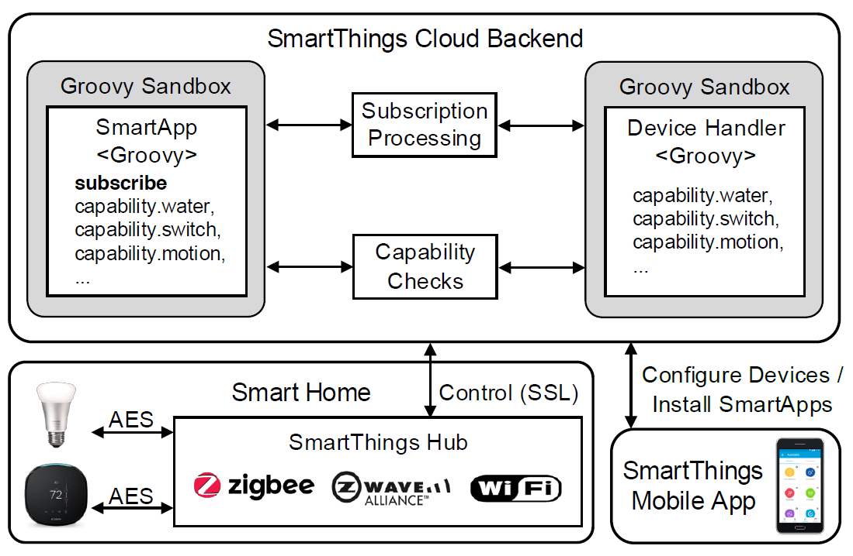
SmartThings- Architecture
A popular platform promoted by Samsung
A developer-friendly ecosystem
Support 133 device types and 181 SmartApps in the official GitHub repo
Notes:
Talk about SmartThings Mobile App here

Slide 6
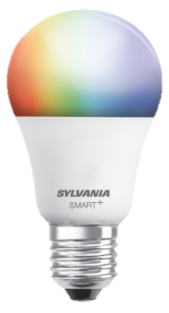
How does SmartThings work?
SmartThings Cloud Backend
Brain of smart home
Remotely control smart devices
Communicate with user
Host device handlers and SmartApps
Smart Apps
Groovy-based programs that automate devices with capabilities.
181 SmartApps (open source) in the official GitHub repository.
52 SmartApps (closed source) in SmartThings Marketplace.
Device Handler
Virtual representation of physical devices
Specify the capabilities of communicating devices and details of protocols.
Commands
on()
off()
Capability
switch

Slide 7
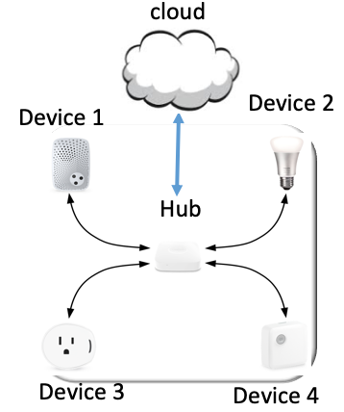
Smart Home
The Smart Home consists of two main parts:
Smart Devices
Key building blocks of the entire infrastructure
Connect to the hub with communication protocols
SmartThings Hub
Mediate the communication with all connected devices
Serve as the gateway to the SmartThings cloud.
Communication Protocols for Smart Home
Wireless Standards of communication protocols in Smart Home
Low data Transmission Rate
Low power consumption
Support AES encryption

Slide 8
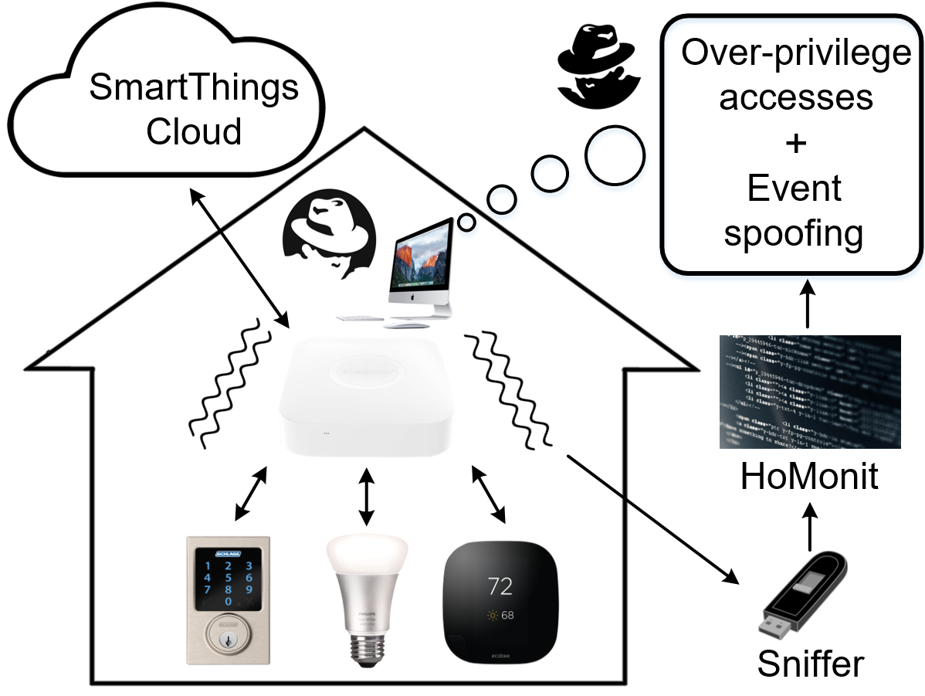
Threat Model – Smart Home Security
There are design vulnerabilities of SmartThings.
Over-priviliged access
gaining control of the smart device capabilities which are not granted by the user
Event spoofing
spoofing event on cloud backend to trigger actions
Defensive works on the vulnerabilities involve platform modification/ patching smart app as specified by Flowfence (USENIX Security 2016), ContexIoT (NDSS 2017), SmartAuth (USENIX Security 2017)

Slide 9
Approach in paper : HoMonit
Is it possible to find a Smart app misbehavior detection system without platform modification or app patching?
HoMonit: a novel platform-independent anomaly detection system for monitoting SmartHome apps to detect SmartApp misbehavior from the encrypted traffic.

Slide 10
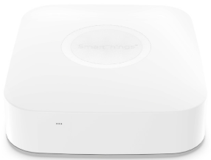
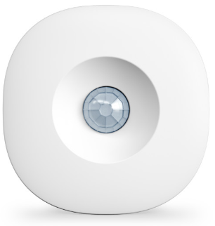
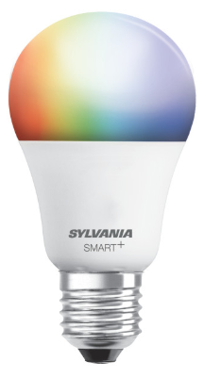
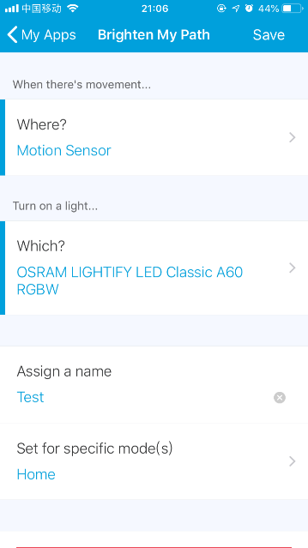
Motivation
Motion
Hub
Switch
SmartApp

Slide 11
Motivation
Motion
Hub
Switch
SmartApp

Slide 12
Motivation
Motion
Hub
Switch
SmartApp

Slide 13
Motivation
similar
Motion
Hub
Switch
SmartApp

Slide 14
Motivation
different
Motion
Hub
Switch
SmartApp

Slide 15
Motivation
Another observation
Traffic → state machine
Working logic → state machine
SmartApp

Slide 16
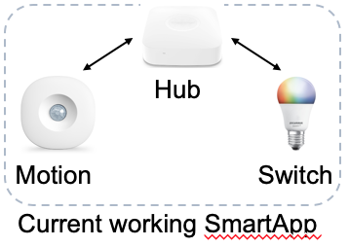
Basic Idea of HoMonit
sniffer
infer
Misbehaviors
Over-privileged access
Event Spoofing
Inconsistent working logic

Slide 17
Research Challenges to be addressed while developing HoMonit
How to automatically extract the control logic (i.e., DFA) of both open-source and closed-source SmartApps?
How to automatically capture wireless traffic (i.e., ZigBee and Z-Wave) and conduct side-channel inference to detect SmartApp misbehaviors?
How to implement and evaluate detection accuracy in a real-world smart home deployment?

Slide 18
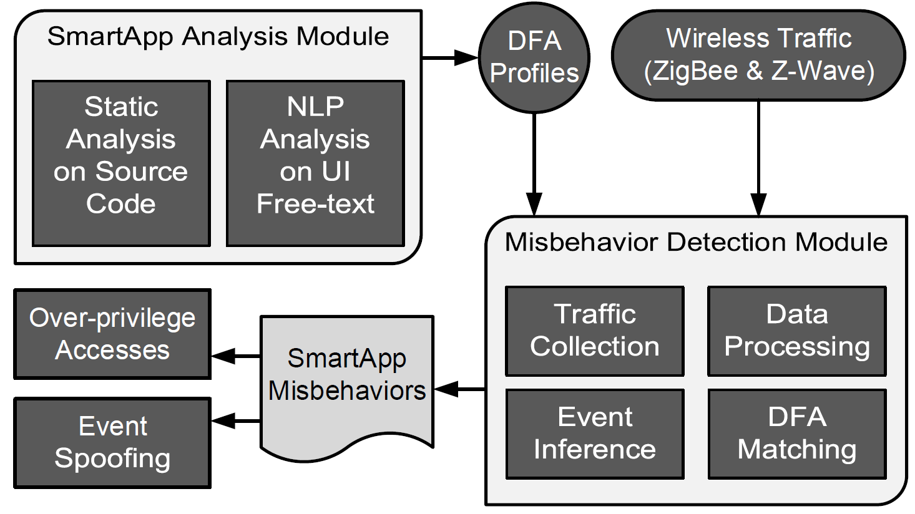
Design Overview – System Workflow
How to extract the control logic of both SmartApps?
How to capture wireless traffic and conduct side-channel inference?

Slide 19
Building DFA via SmartApp Analysis
Deterministic Finite Automaton (DFA) was used to model SmartApp and build the model using app analysis.
App analysis is performed as:
Static code analysis – Open-source apps
NLP analysis – Closed-source apps
start state
accept state
symbol
transition

Slide 20
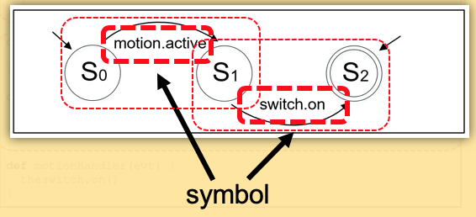
Building DFA for open-source apps
Example: Smart Light
In the code:
Preferences:
Extract Capabilities
Subscribe:
determine symbols - command & attribute
Handler:
intermediate transition
Uses static code analysis approach.
Function: Turns light on when motion is detected – automates two devices.
DFA is built in two steps.
Source → Abstract Syntax Tree (AST) (uses AstBuilder)
AST→ DFA
Translation of AST to DFA is based on ‘SmartApp characteristics’.

Slide 21
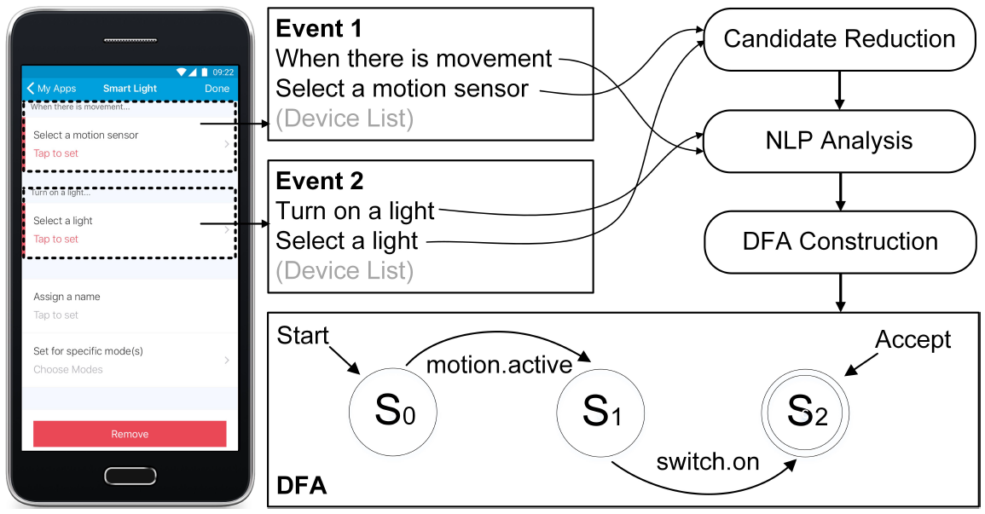
Building DFA for Closed-source apps
Uses NLP analysis approach
Text extraction → Symbol inference → Build DFA
Text extraction : use uiautomator to convert UI hierarchy to XML nodes and then extract text.
Symbol inference: Picking appropriate symbol from the obtained capabilities or attributes set.
It is very difficult to obtain appropriate symbol from the candidate list.
No adequate training data for SmartThings
Hence, directly applying NLP for UI text cannot achieve good performance.
Author’s strategy: To reduce candidate number of capabilities before using NLP and use NL ToolKit.
Notes:
Now we starting looking at app interface. That is UI of the app.

Slide 22
NLP analysis
NLTK : extract the noun phases and verb phrased for capability analysis
water → Water Sensor
Word2Vec : analyze the context of the verb phrases and then determine the state of attributes or commands
when water is sensed → water.wet

Slide 23
DFA Building
UI design follows the symbol logical relationship
Chain the symbols according to the UI layout
“ When there is movement, turn on a light ”

Slide 24
Misbehavior Detection-Wireless Fingerprint
The process of Misbehavior detection includes – Traffic collection, Event Inference, DFA Matching.
Traffic collection : ZigBee traffic, Z-wave traffic.
Filtering noise traffic:
Beacon packets: Acknowledging data transmission and maintain established connection.
Retransmission packets: Used during transmission failure.
Unrelated traffic: Traffic from devices using other wireless.
Fingerprinting events: Use Levenshtein Distance (LD) to measure similarity between packet sequence.
Inferring events: Divide traffic flow into set of bursts, and match the burst with calculated LD.
Traffic Collection
Filtering Noise Traffic
Fingerprinting events
Inferring events
Event Inference
Notes:
Finger print, eventtype, collected packet sequence.

Slide 25
Fingerprints for event types – Various devices

Slide 26
DFA Matching Algorithm
Input
A sequence of events
Output
Accept state:
Otherwise, misbehaved app detected.
Process
Initially S₀ = q₀

Slide 27
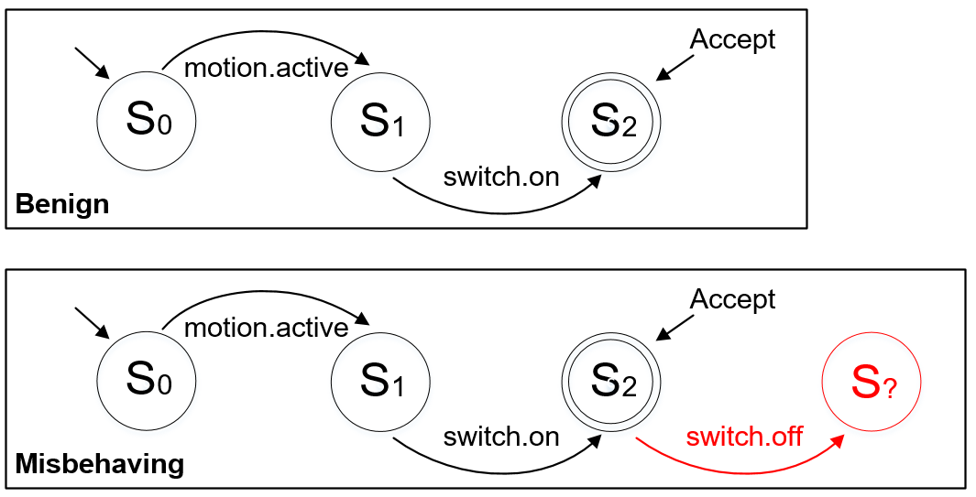
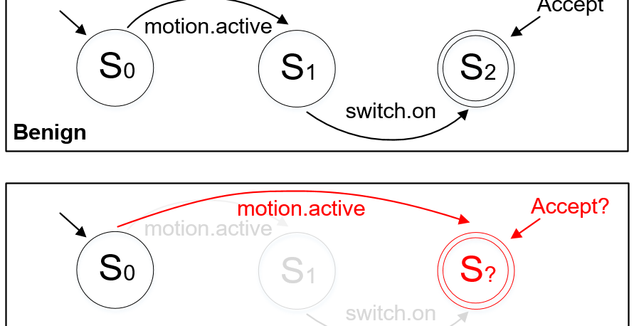
Misbehavior detection in SmartApps
Over-privileged access:
Rising extra device event
Event Spoofing:
Skipped States

Slide 28
Evaluation - Metrics
TP (true positive) : Correctly labeled misbehaving SmartApp
TN (true negative) : Correctly labeled benign SmartApp
FP (false positive) : Incorrectly labeled benign SmartApp
FN (false negative) : Incorrectly labeled misbehaving SmartApp
TPR (true positive rate) : TPR = TP / (TP + FN)
TNR (true negative rate) : TNR = TN / (FP + TN)

Slide 29
Misbehavior Detection Results
The average TPR for over-privileged accesses is 0.98
The average TPR for event spoofing is 0.99
Failed test case reason : packet loss, unexpected wireless traffic, accidental signal reception delay

Slide 30
Discussions
Authors:
Claimed that the approach can be potentially applied to other IoT systems.
Investigated on IFTTT(an open source platform compatible with SmartThings) and stated HoMonit has its own applicability and generality.
State that the events present the same wireless fingerprints & Applets share similar logic.
Drawbacks:
Side-channel information leakage – requires wireless sniffer in proximity of smarthome.
The attacker can spy on the victim’s daily activities
The attacker can infer it by detecting the app existence
The attacker can infer the health condition of residents

Slide 31
Conclusion
An anomaly detection system for smart home platforms to detect misbehaving SmartApps
HoMonit
Leverage the side-channel information leakage in the wireless channel to infer device event
Insight
Program logic extraction from source code or UI, and auto DFA construction & matching algorithms
Contribution
HoMonit can effectively validate the working logic of SmartApps and achieve a high accuracy in the detection of SmartApp misbehaviors
Performance

Slide 32
THANK YOU!!!

